Slide 1

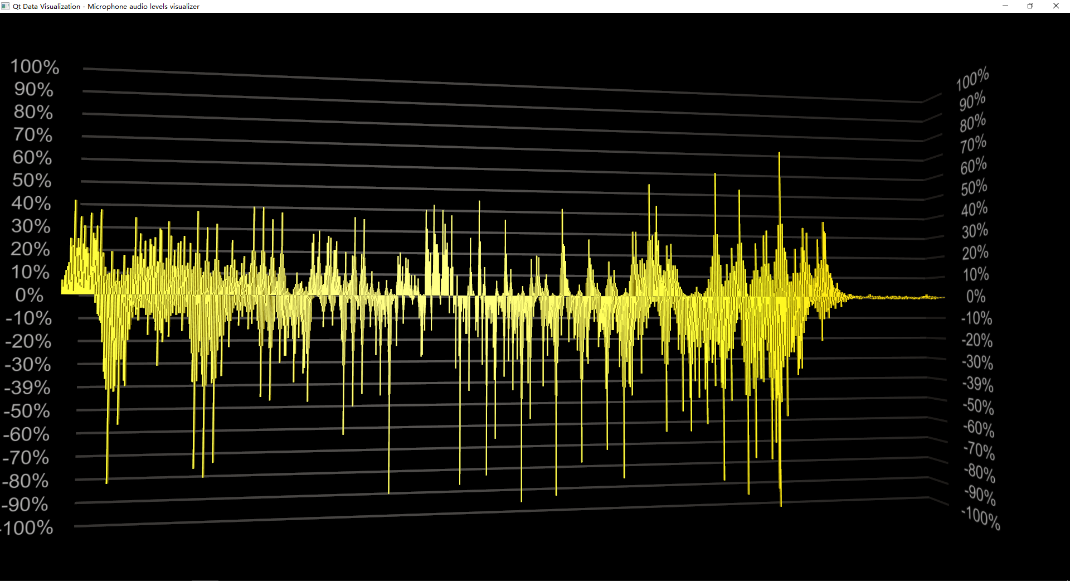
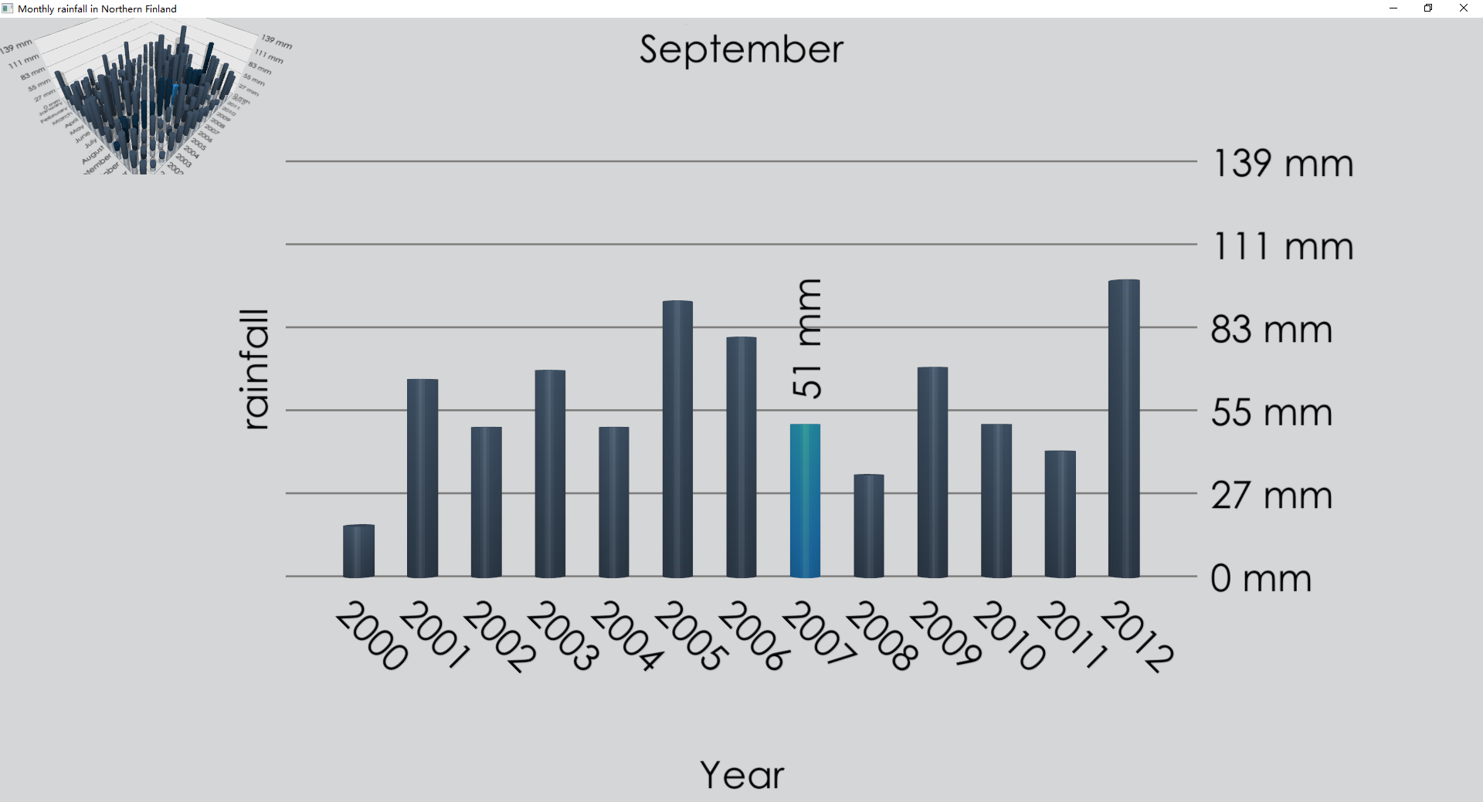
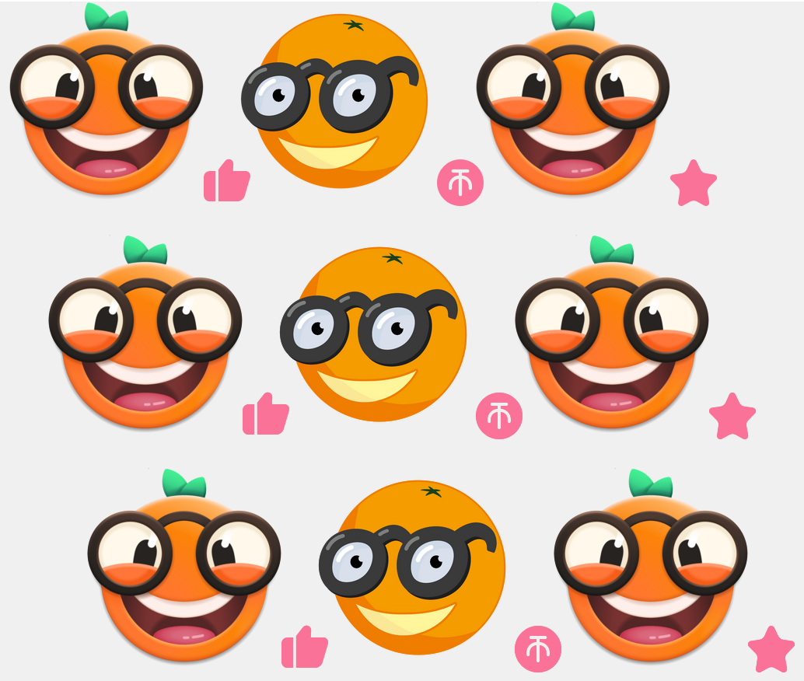

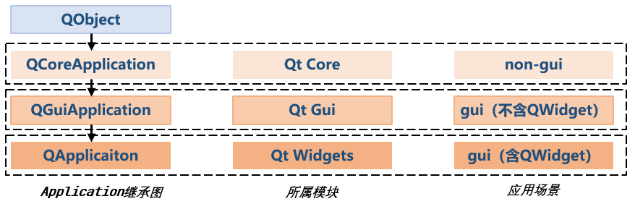





2.3 Application相关
made by 我不是Qt
Every individual is different and talented, what you need are passion.

Slide 2
目录/CATALOG
01
04
Application相关的几个类
QApplication
02
QCoreApplication
03
QGuiApplication

Slide 3
01Application相关的几个类
QObject
QCoreApplication
Qt Core
non-gui
QGuiApplication
Qt Gui
gui（不含QWidget）
QApplicaiton
Qt Widgets
gui（含QWidget）
Application继承图
所属模块
应用场景
使用时机:
如果应用是无界面的 -> QCoreApplication
如果应用有界面
未涉及Qt Widgets模块 -> QGuiApplication
涉及到Qt Widgets模块 -> QApplication

Slide 4
02 QCoreApplication
一句话概括QCoreApplication
The QCoreApplication class provides an event loop for Qt applications without UI.
QCoreApplication 包含主事件循环,里面处理着来自操作系统以及应用系统本身的各种事件；它也负责应用程序的初始化、终止化以及系统相关的设置
类属性
QString applicationName
QString applicationVersion
QString organizationDomain
QString organizationName
bool quitLockEnabled
公共函数
QCoreApplication(int &argc, char **argv)
virtual ~QCoreApplication()
void installNativeEventFilter(QAbstractNativeEventFilter *filterObj)
virtual bool notify(QObject *receiver, QEvent *event)
void removeNativeEventFilter(QAbstractNativeEventFilter *filterObject)
信号
void aboutToQuit()
void applicationNameChanged()
void applicationVersionChanged()
void organizationDomainChanged()
void organizationNameChanged()
公共槽
void quit()
公共静态函数
QString applicationDirPath()
QString applicationFilePath()
QString applicationName()
QString applicationVersion()
QStringList arguments()
int exec()
QCoreApplication * instance()
QString organizationDomain()
QString organizationName()
...
重写父类方法
virtual bool event(QEvent *e) override

Slide 5
02 QCoreApplication
applicationDirPath()
applicationFilePath()
libraryPaths ()
setLibraryPaths ()
addLibraryPath ()
removeLibraryPath ()
QLibrary
exec ()
processEvents ()
sendEvent ()
postEvent ()
removePostedEvents () sendPostedEvents ()
QCoreApplication重点内容介绍
QCoreApplication用于非GUI的应用程序，例如控制台、服务进程等
QCoreApplication用于事件循环、事件处理、路径（应用程序路径、插件搜索路径）、翻译、获取命令行参数、本地设置等功能
类属性
applicationName
applicationVersion
organizationDomain
organizationName
installTranslator()
removeTranslator()
translate()
arguments()
QCommandLineParser

Slide 6
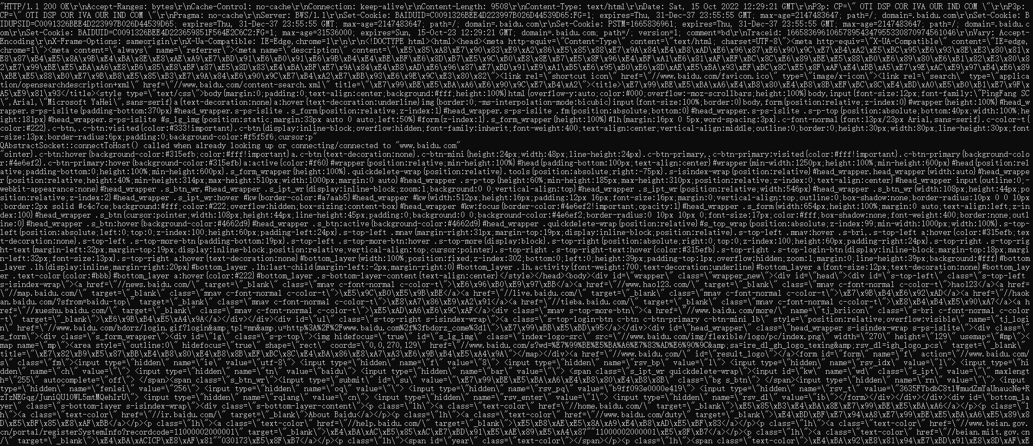
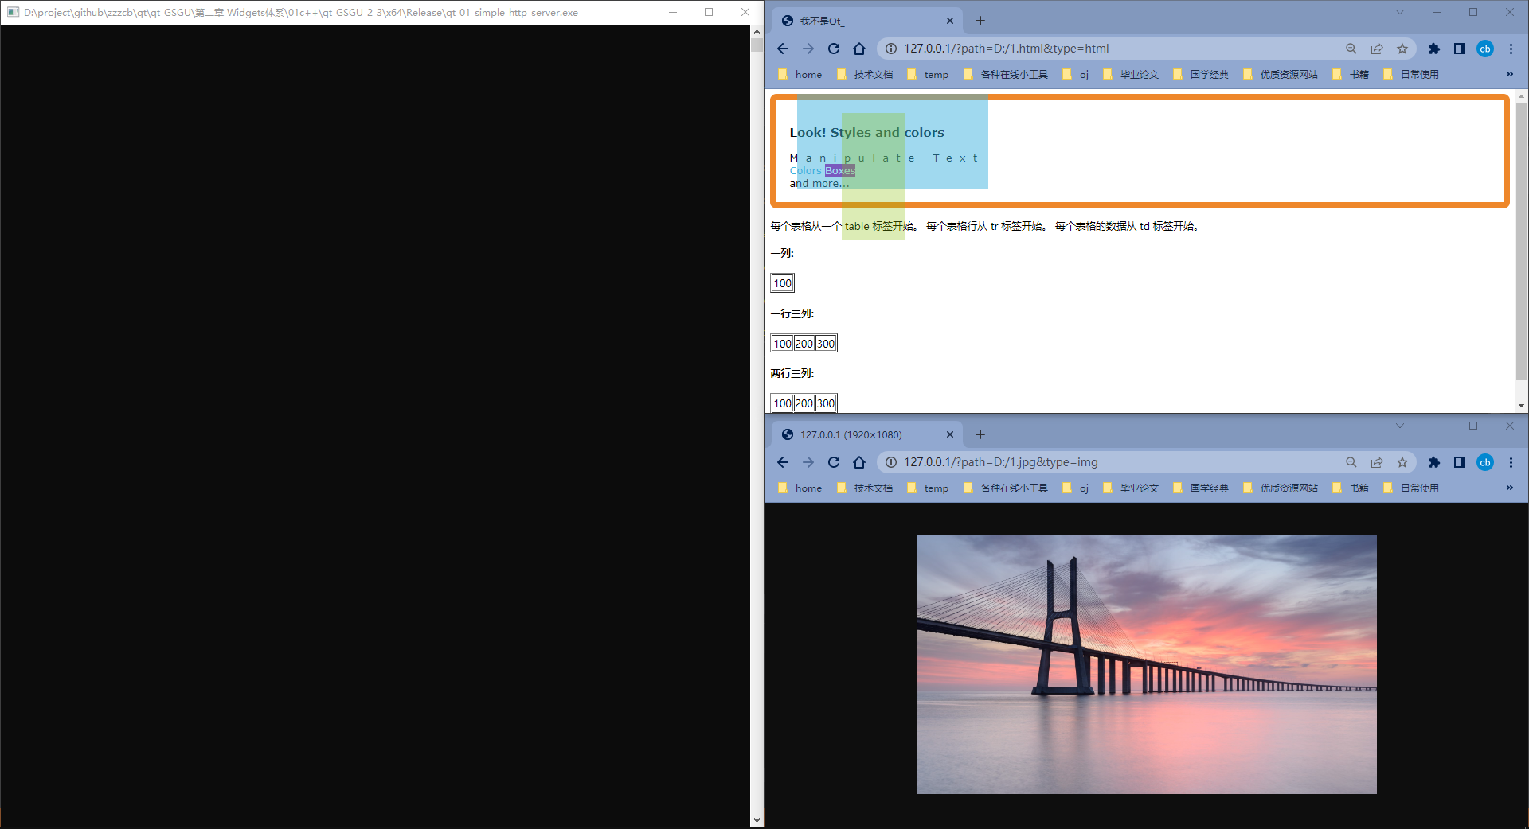
02 QCoreApplication 举例
crazy http client
www.baidu.com
simple http server
http://127.0.0.1

Slide 7
03 QGuiApplication
一句话概括QGuiApplication
The QGuiApplication class manages the GUI application's control flow and main settings.
QGuiApplication拥有QCoreApplicaition的所有功能，它管理着GUI应用的控制流和一些设置，及自己的特有功能
类属性
QString applicationDisplayName
QString desktopFileName
Qt::LayoutDirection layoutDirection
const QString platformName
QScreen* const primaryScreen
bool quitOnLastWindowClosed
Qicon windowIcon
公共函数
QGuiApplication(int &argc, char **argv)
virtual ~QGuiApplication()
qreal devicePixelRatio() const
bool isSavingSession() const
bool isSessionRestored() const
QString sessionId() const
QString sessionKey() const
信号
void applicationDisplayNameChanged()
void applicationStateChanged(Qt::ApplicationState state)
void commitDataRequest(QSessionManager &manager)
void focusObjectChanged(QObject *focusObject)
void focusWindowChanged(QWindow *focusWindow)
void fontChanged(const QFont &font)
void fontDatabaseChanged()
void lastWindowClosed()
void layoutDirectionChanged(Qt::LayoutDirection direction)
void paletteChanged(const QPalette &palette)
void primaryScreenChanged(QScreen *screen)
void saveStateRequest(QSessionManager &manager)
void screenAdded(QScreen *screen)
void screenRemoved(QScreen *screen)
公共静态函数
Qstring applicationDisplayName()
QClipboard *clipboard()
QString desktopFileName()
int exec()
QObject * focusObject()
QWindow * focusWindow()
QWindow * modalWindow()
QPalette palette()
QString platformName()
QScreen * primaryScreen()
void restoreOverrideCursor()
QScreen * screenAt(const QPoint &point)
QList<QScreen *> screens()
void setPalette(const QPalette &pal)
void setWindowIcon(const QIcon &icon)
QIcon windowIcon()
…
宏
qGuiApp
重写父类方法
virtual bool notify(QObject *object, QEvent *event) override
virtual bool event(QEvent *e) override

Slide 8
03 QGuiApplication
palette()
font()
styleHints()
QGuiApplication重点内容介绍
QGuiApplication用于GUI的应用程序（不涉及QWidget）
QGuiApplication提供了根据平台设置初始化应用程序、事件循环、事件处理、解析命令行参数、翻译、特殊对象、窗口系统、鼠标光标、会话管理等功能
translate()
sendEvent()
postEvent()
setOverrideCursor()
arguments()
QCommandLineParser
isSessionRestored()
sessionId()
commitDataRequest()
saveStateRequest()
topLevelAt()
topLevelWindows()
clipboard()

Slide 9
03 QGuiApplication
Type | Related function
System settings（系统设置） | desktopSettingsAware() setDesktopSettingsAware() styleHints() palette() setPalette() font() setFont()
Event handling（事件处理） | exec() processEvents() exit() quit() sendEvent() postEvent() sendPostedEvents() removePostedEvents() hasPendingEvents() notify()
Windows（窗口） | allWindows() topLevelWindows() focusWindow() clipboard() topLevelAt()
Advanced cursor handling（光标） | overrideCursor() setOverrideCursor() restoreOverrideCursor()
Session management（会话管理） | isSessionRestored() sessionId() commitDataRequest() saveStateRequest()
Miscellaneous（其他） | startingUp() closingDown()

Slide 10
03 QGuiApplication 举例
Audio Level
Custom Proxy

Slide 11
04 QApplication
一句话概括QApplication
The QApplication class manages the GUI application's control flow and main settings.
QApplication拥有着QCoreApplication和QGuiApplication的所有功能及自己的特有功能
类属性
bool autoSipEnabled
int cursorFlashTime
int doubleClickInterval
QSize globalStrut
int keyboardInputInterval
int startDragDistance
int startDragTime
QString styleSheet
int wheelScrollLines
QIcon windowIcon
公共静态函数
QWidget * activeModalWidget()
QWidget * activePopupWidget()
QWidget * activeWindow()
void alert(QWidget *widget, int msec = 0)
QWidgetList allWidgets()
void beep()
int cursorFlashTime()
QDesktopWidget * desktop()
int doubleClickInterval()
int exec()
QWidget * focusWidget()
QFont font()
QFont font(const QWidget *widget)
QFont font(const char *className)
QPalette palette(const QWidget *widget)
QPalette palette(const char *className)
void setDoubleClickInterval(int)
void setFont(const QFont &font, const char *className = nullptr)
void setPalette(const QPalette &palette, const char *className = nullptr)
void setWindowIcon(const QIcon &icon)
QWidget * widgetAt(const QPoint &point)
QWidget * widgetAt(int x, int y)
QIcon windowIcon()
...
信号
void focusChanged(QWidget *old, QWidget *now)
公共槽
void aboutQt()
bool autoSipEnabled() const
void closeAllWindows()
void setAutoSipEnabled(const bool enabled)
void setStyleSheet(const QString &sheet)
公共函数
QApplication(int &argc, char **argv)
virtual ~QApplication()
QString styleSheet() const
重写父类方法
virtual bool notify(QObject *object, QEvent *event) override
virtual bool event(QEvent *e) override
宏
qApp

Slide 12
04 QApplication
palette()
font()
doubleClickInterval()
QApplication重点内容介绍
QApplication用于GUI的应用程序（涉及QWidget）
QApplication提供了根据平台设置初始化应用程序、事件循环、事件处理、解析命令行参数、翻译、特殊对象、窗口系统、鼠标光标、外观设置等功能
translate()
sendEvent()
postEvent()
setOverrideCursor()
arguments()
QCommandLineParser
setStyle()
QStyle
topLevelWidgets()
closeAllWindows()
widgetAt()
clipboard()
desktop()

Slide 13
03 QApplication
Type | Related function
System settings（系统设置） | desktopSettingsAware() setDesktopSettingsAware() cursorFlashTime() setCursorFlashTime() doubleClickInterval() setDoubleClickInterval() setKeyboardInputInterval() wheelScrollLines() setWheelScrollLines() palette() setPalette() font() setFont() fontMetrics()
Event handling（事件处理） | exec() processEvents() exit() quit(). sendEvent() postEvent() sendPostedEvents() removePostedEvents() hasPendingEvents() notify()
GUI Styles(风格) | style() setStyle()
Widgets（窗口控件） | allWidgets() topLevelWidgets() desktop() activePopupWidget() activeModalWidget() clipboard() focusWidget() activeWindow() widgetAt()
Advanced cursor handling（光标） | overrideCursor() setOverrideCursor() restoreOverrideCursor()
Miscellaneous（其他） | closeAllWindows() startingUp() closingDown()

Slide 14
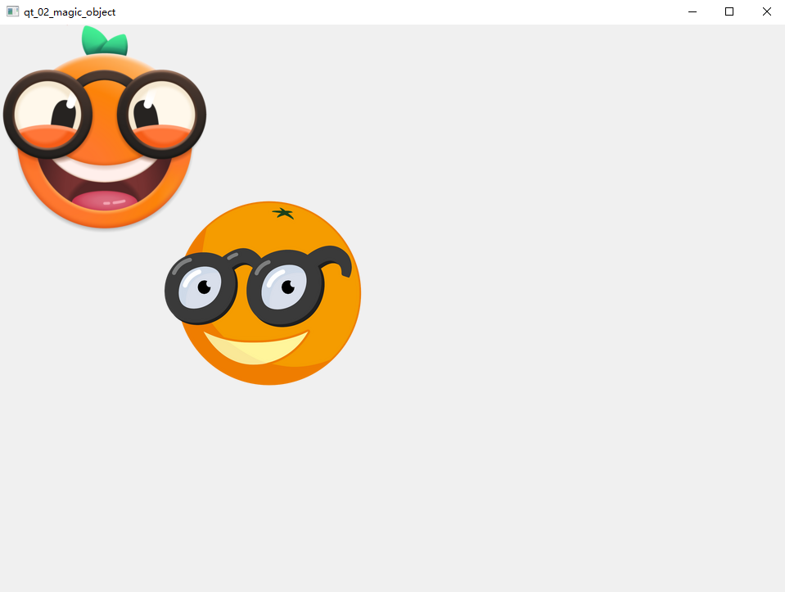
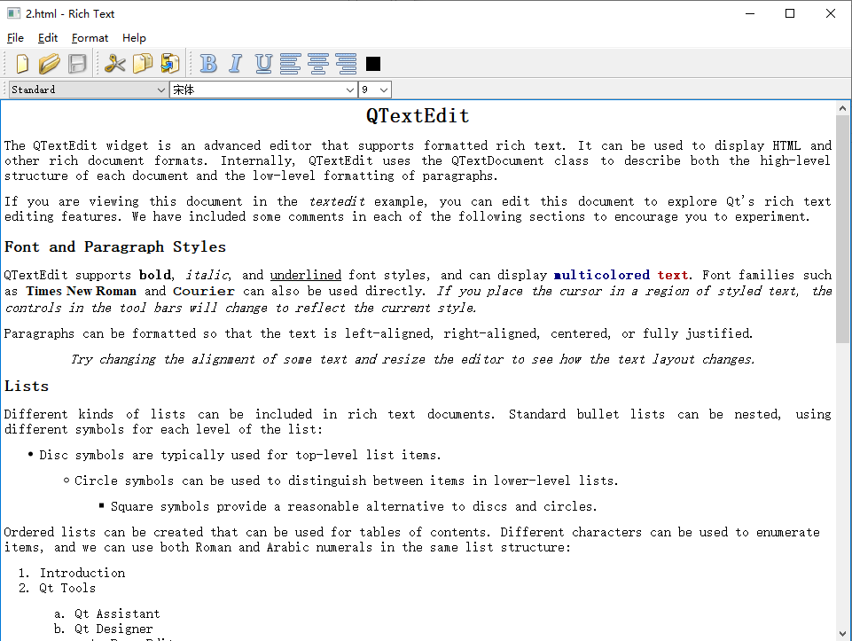

04 QApplication 举例
桌面/剪切板/复制/粘贴
命令行参数解析/配置文件/日志/缓存

Slide 15
Thank You
https://github.com/zzzcb
https://cnblogs.com/zach0812
https://space.bilibili.com/441821181
made by 我不是Qt
Every individual is different and talented, what you need are passion.

